Slide 1
A Political Geographer’s Perspective on Ukrainians and Their Territory
Presented by Meryl McBride
(aka Merrill Johin in SL or Merrill Johnson, PhD,
Professor of Geography, Colorado State University)

Slide 2
To examine the historical and geographical context of the world in which Ukrainians live, and how it relates to the current crisis with Russia. Specific questions include:
What are the cultural/territorial roots of Ukraine?
What were the geographical consequences of Russian/Soviet ascendancy?
How did Ukraine become a “shatterbelt”?
Are Ukrainians a “nation”; is Ukraine a “state?”
What is the “logic” of recent territorial conflicts?
Purpose of Presentation

Slide 3
In the Beginning (Sort of): Cultural/Territorial Roots of Ukraine
The Kievan Rus Period: Early Slavic/Nordic States
Who were the Slavs? East Slavs to Russian forests after fall of Rome . . . agriculture, trade . . . focus on Dnieper (Dnepr) River . . .
Kyiv
(ca. 1054)
Dnieper
(Dnepr)
River
3
Notes:
Settled in family groups, communes. Mainly traders—honey, wax, furs.

Slide 4
The Norse (Vikings, Varangians) invited to defend Novgorod (862) . . stayed on . . . to Kiev by 882, creating Kievan Rus state . . . . Norse called “Rus”--hence “Russia” . .
Kyiv became center of state, great European city by 1000s . . .
Norse
Kyiv
Novgorod
Dnieper
River
4
Notes:
Rurik—successors became princes of Kiev. Were traders and warlords. Yaroslav I ruled 1019-54 at apex of greatness.

Slide 5
The Tatar (Mongolian) Period . . .
Mongolian invasions (ca. 1238-1240) . . . invaders from Asia (the “Golden Horde,” “Tatar Yoke”—until ca. 1480) . . . destroyed Kievan Rus . . . Novgorod largely spared. Created tribute states ruled by Russian princes in service to Tatars . . . tribute heavy--famine, destruction . . . but church survived . . .
Kyiv
Novgorod
Tatars
Dnieper
River
5
Notes:
Novgorod was largely spared—was Baltic trading city.

Slide 6
Impact on Russian development . . . eastern focus, isolation from West . . . authoritarian mindset??
Russian migrations . . . Great Russians, White Russians, Ukrainians . . .
White
Russians
Great
Russians
Ukrainians
6

Slide 7
Moscow’s Ascendency
The Rise of Muscovy and Siberian Expansion . . .
Appearance of Moscow-dominated state (late 1300s) . . . focus on Muscovy (later Moscow) . . . center of Great Russians . . . expansion by Moscow led to creation of Russian Empire . . .
Muscovy
ca.1300
7
Notes:
Battle of Kulikova 1380. By 1480, Horde finally defeated.

Slide 8
The Ivanov dynasty led early conquests . . .
First of czars (or tsars)
Ivan III (Great) (rule: 1462-1505) ejected Tatars . . . Ivan IV Terrible) (1547-84)
Polish-Lithuanian
Commonwealth
Muscovy
(Moscow)
1462
1533
Mainly northward expansion and into Siberia . . .
1584
Tatars/
Ottomans
8
(Yakutsk by 1632, Pacific by 1648 . . . Later czars)

Slide 9
Expansion Toward West and South
Rise of Romanov dynasty after collapse of Ivanov dynasty between 1584-1613 . . .
Peter I (the Great), who was the third Romanov and ruled from 1682-1725, led the charge . . . literally . . . Exceptional curiosity about West . . . Grand Embassy (1697) . . .
Peter
Adapted from R. Coughlan, Elizabeth and Catherine (New York: Putnam, 1974).
9
Notes:
Taxable items: lands, rents, horse collars, hats, boots, horse hides, beehives, hot baths, chimney stacks, beards, moustaches, nuts, watermelons, cucumbers. Soul tax.

Slide 10
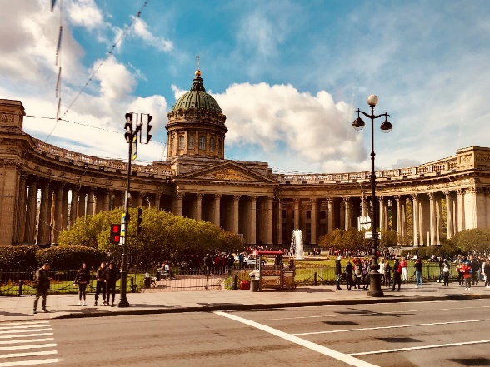
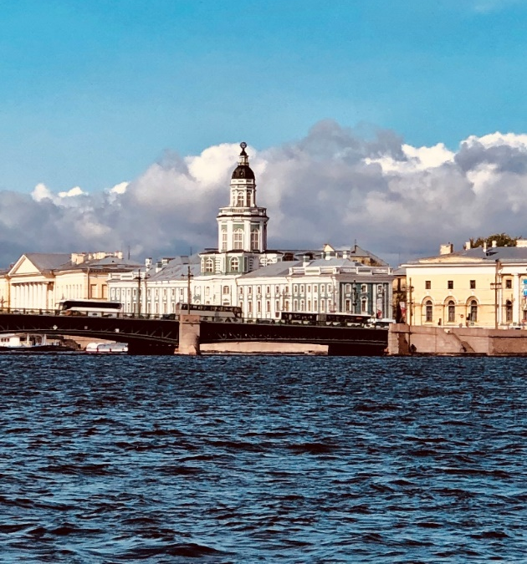
European expansion under Peter I . . . motive: increase access to western Europe (why important?), but needed warm-water port . . . . . . .
St. Petersburg--became capital of Empire (later Leningrad) . . . Window on the West . . .
St. Petersburg
(1713)
10
Notes:
Michael Romanov—1613-45. Alexis—1645-76. Cluttered ascendancy until 1694—Sophia, half brother.

Slide 11
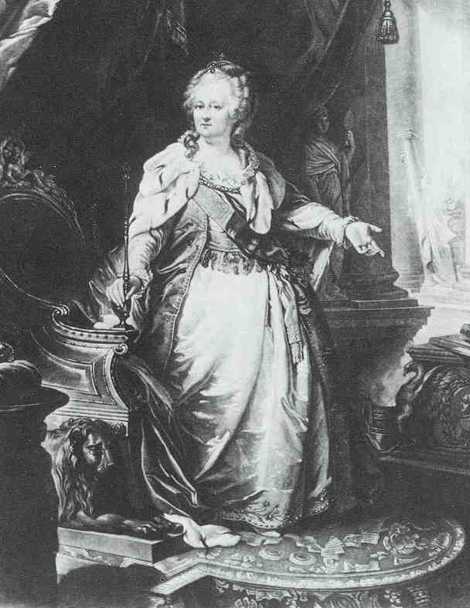
More expansion Toward West and South
Catherine II (the Great, rule 1762-96) . . . focused on conquests in the Black Sea region, Poland, Ukraine . . .
Catherine
Catherine
(and others)
11

Slide 12
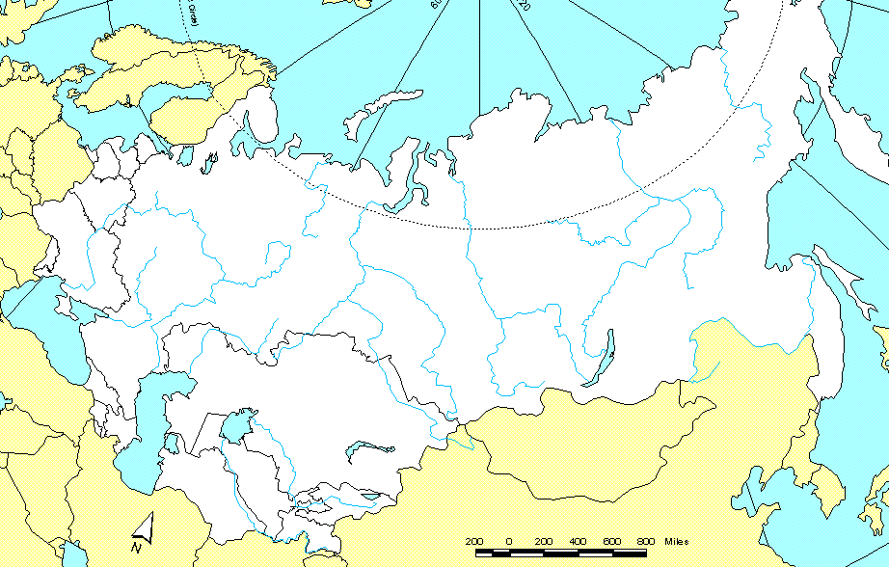
Geographical Consequences of Russian/Soviet Ascendancy
The Russian Empire before World War I . . . larger than the former Soviet Union . . . Note Finland, Poland . . .
1763- 1800
1809
1697- 1732
1815
1638
1770s
1649
1780s
1596-1689
1810-20s
1652
1860
1850-60s
1880s
12

Slide 13
Soviet Socialist Republics
Bolshevik Revolution and the Soviet, Socialist, Republic . . . (SSR) . . .
Why create SSR?
Criteria used for creation: --More than 1 mm people not Russian, but in same group --Border with outside world
Large groups left in Russia . . . Tatars, Yakuts, Karelians . . .
13

Slide 14
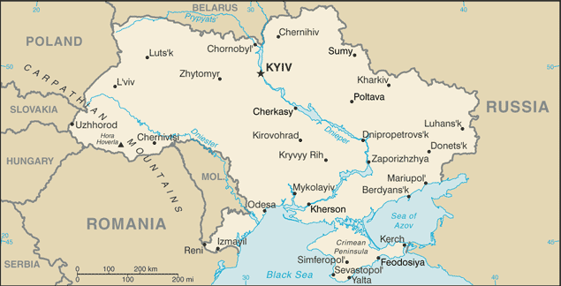
The Ukrainian “Shatterbelt”
The generalized political map in 1400 (using the current political map as a base). Mainly non-Russian empires had competing interests in Ukraine . . .
Poland-Lithuania
Golden Horde/
Tatars
Adapted from Centennia Historical Atlas, as portrayed in http://brenocon.com/ukraine_maps/. Accessed 3-3-2022. Base map from Perry-Castaneda Library Map Collection, University of Texas.
14

Slide 15
The map in 1600. Russians began to take an interest in Ukraine . . .
Russia
Poland-Lithuania
(Mainly Poland)
Crimean
Khanate
Adapted from Centennia Historical Atlas, as portrayed in http://brenocon.com/ukraine_maps/. Accessed 3-3-2022. Base map from Perry-Castaneda Library Map Collection, University of Texas.
15

Slide 16
The map in 1655. Poland lost control of central Ukraine to Zaporizhian Cossacks, but not for long . .
Russia
Poland)
Ukrainian
Cossacks
Crimean
Khanate
Adapted from Centennia Historical Atlas, as portrayed in http://brenocon.com/ukraine_maps/. Accessed 3-3-2022. Base map from Perry-Castaneda Library Map Collection, University of Texas.
16

Slide 17
Map in 1700: Cossack territory was split between Russia and Poland in 1667 with the Dnieper River as the dividing line . . .
Poland
(Right Bank)
Russia
(Left Bank)
Crimean Khanate
(Ottomans)
Adapted from Centennia Historical Atlas, as portrayed in http://brenocon.com/ukraine_maps/. Accessed 3-3-2022. Base map from Perry-Castaneda Library Map Collection, University of Texas.
17

Slide 18
The map in 1800 . . . The division of Poland among Austria, Prussia, and Russia left Russia controlling former Polish territory (shared with Austria-Hungary)
Austria-
Hungary
Russia
Adapted from Centennia Historical Atlas, as portrayed in http://brenocon.com/ukraine_maps/. Accessed 3-3-2022. Base map from Perry-Castaneda Library Map Collection, University of Texas.
18

Slide 19
The map in 1920 . . . World War I, the Bolshevik Revolution, the Treaty of Brest-Litovsk, World War II . . . territorial chaos . . .
Poland
Ukraine
(USSR)
Czechoslovakia
Romania
Adapted from Centennia Historical Atlas, as portrayed in http://brenocon.com/ukraine_maps/. Accessed 3-3-2022. Base map from Perry-Castaneda Library Map Collection, University of Texas.
19

Slide 20
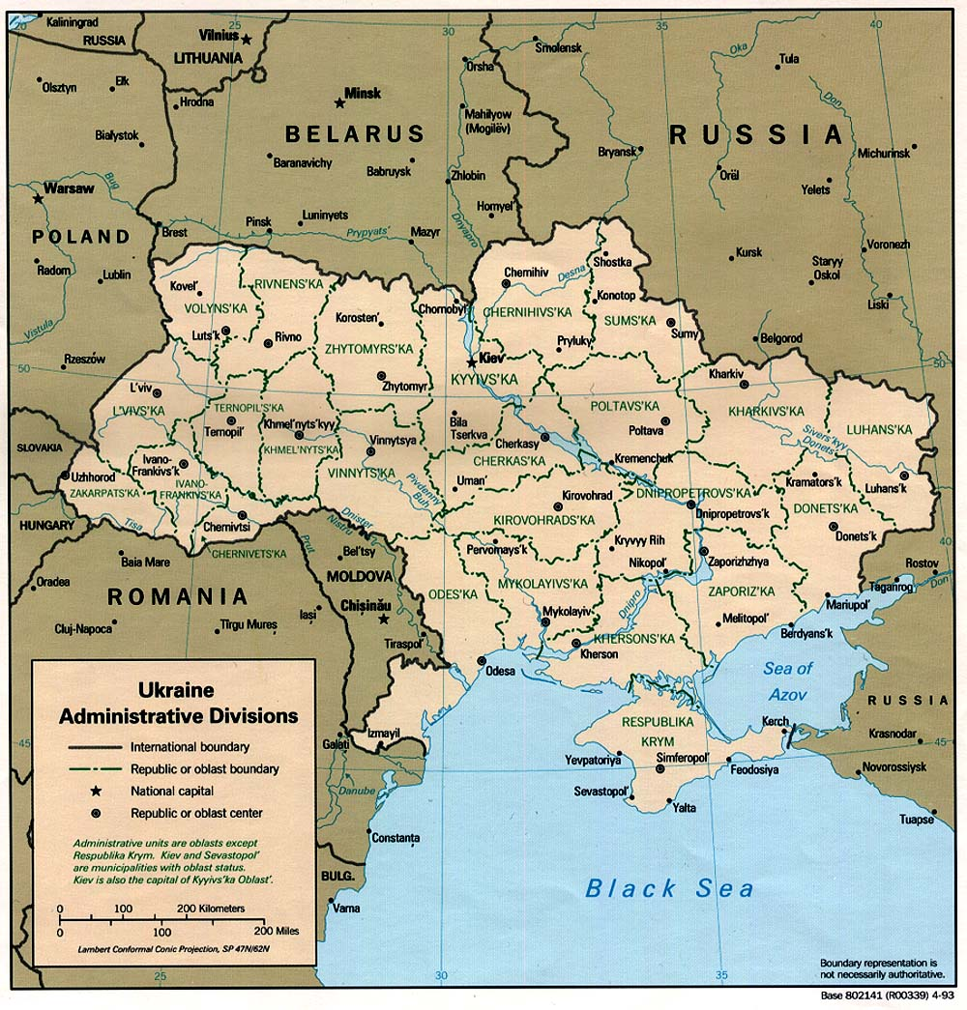
The current map? . . .
Added
1921,24
(Lenin’s gift!)
Added
1954
Base map from Perry-Castaneda Library Map Collection, University of Texas.
20

Slide 21
Are Ukrainians a “Nation”; Is Ukraine a “State”
How do geographers define a “nation”? . . .
“. . . a community of people who feel that they belong together in the double sense that they share deeply significant elements of a common heritage and that they have a common destiny . . .”
Language, religion,
customs, myths, etc.
Community commanding
loyalty . . .
To do what?
Create a state?
21
[from Emerson, in Williams (PHG, 1985)]

Slide 22
How do geographers define a “state”? . . .
“. . . an entity that has a defined territory and a population under the control of a government that engages in foreign relations . . .” [R.I.L., 1965]. Technically, a “state” is not a “nation.”
Usually, to be a state, two political criteria must be satisfied:
Sovereignty (at least de jure) . . .
International recognition (exchange of ambassadors, etc.)
22

Slide 23
The “Logic” of Recent Territorial Conflicts
The Crimea . . . Geographers talk about “justifications” for claiming territory. Here are common justifications from both sides:
Ukraine
Since Crimea was part of Ukraine in 1991, and since the SSR boundaries created by the Soviets would be the boundaries of the new republics, Crimea was Ukrainian..
Crimea
23

Slide 24
Everything was finally settled in the tripartite (U.S., UK. Russian) Budapest Memorandum of 1994 which, in return for Ukrainian renunciation of nuclear weapons, Ukraine’s existing borders were guaranteed.
Crimea
Respect for Ukraine’s borders, as well as assurances against the use of force, was confirmed by the 1997 Treaty on Friendship, Cooperation and Partnership between Russia and Ukraine. . .
Autonomy granted to Crimea by Ukraine would assuage Crimean sensitivities, and would be sufficient protection for resident Russian interests. . . .
24

Slide 25
Russia (Putin)
The “Nicaragua test”: The “little green men” were like the Nicaraguan Contras, with same int’l protection . . .
Russians were invited to invade . . .
Russians were protecting Russian nationals . . .
Crimea
Russians conducted a referendum, which they won . .
Crimea had a right to “self-determination.” The Kosovo precedent . . .
25

Slide 26
The Donbas . . . More arguments from both sides about the other area of contention.
Ukraine
Ukrainians were there first (the priority justification). Russians came much later.
Donbas
While Russian settlement began in the late 1700s, most of it occurred during the Industrial Revolution and after 1945 . . . Example of “Russification.”
The Bolsheviks included Donetsk in the final SSR boundaries of 1924.
26

Slide 27
Russia
Russians were there first (again, the priority justification).
The Donbas was like the American Old West, and was a frontier region settled by multiple nationalities. Russian became “lingua franca,” like English in Old West . . .
Donbas
The post-1945 “surge” in Russian population was more a result of famine and Nazi depopulation of the Ukrainian countryside during 1930s and 1940s than intentional Russification.
27

Slide 28
Look at all the Russian speakers in eastern and southern Ukraine—sort of a “New Russia.” Political geographers see this as a cultural or “irredentist” justification, whereby one state claims the territory of another based on similar cultural characteristics.
28

Slide 29
Conclusion: Tough Neighborhood
Pure “righteousness” and pursuit of total “truth” can be found in neither the Ukrainian nor Russian causes, but the Ukrainians would seem to have a clear edge in terms of both . . .
Thank you for your attention!!!
29

